Slide 1
Solve Climate By 2030
Solar Dominance + Civic Action
Dr. Eban Goodstein, Bard Graduate Programs in Sustainability

Slide 2
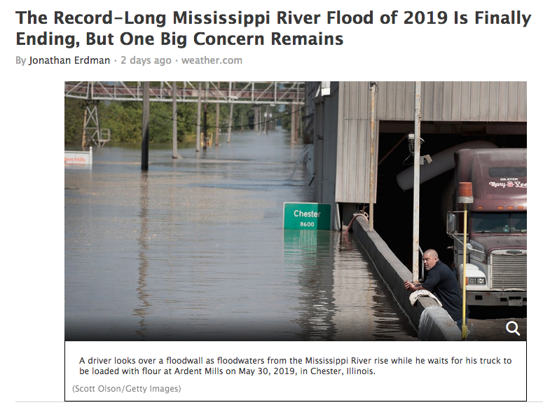
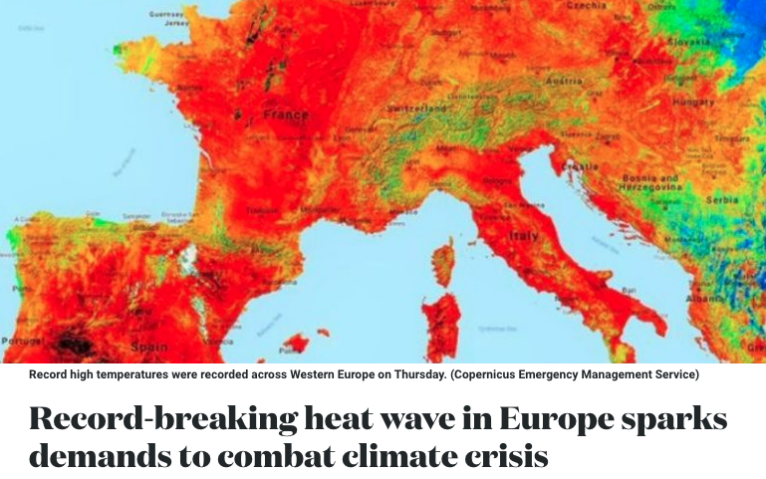
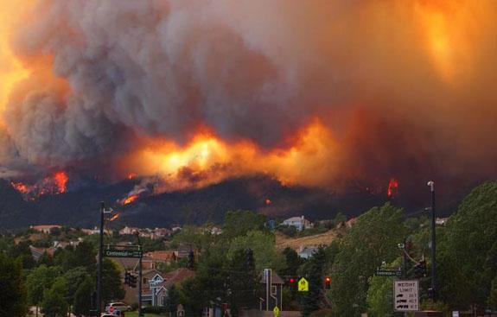
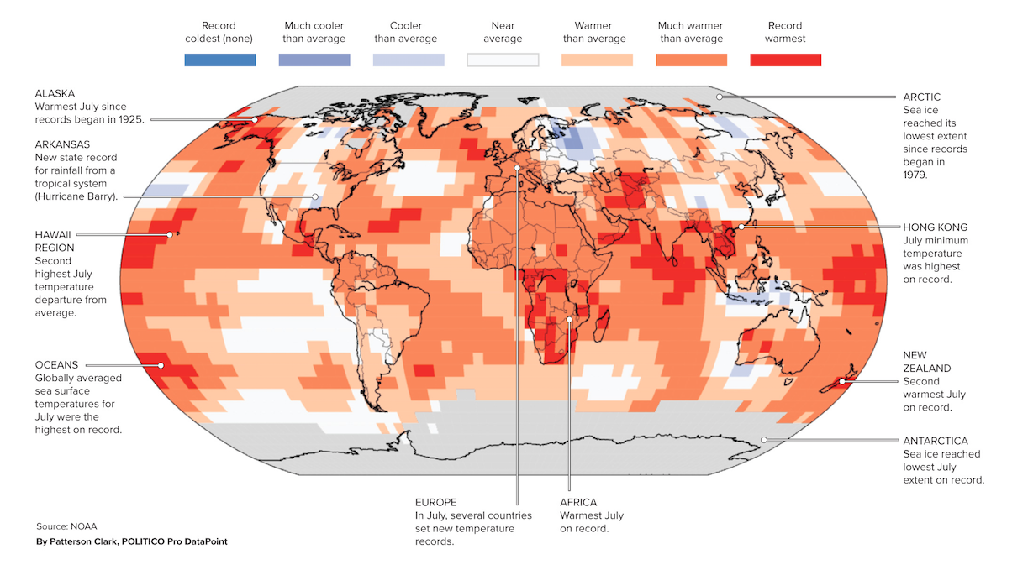

Slide 3
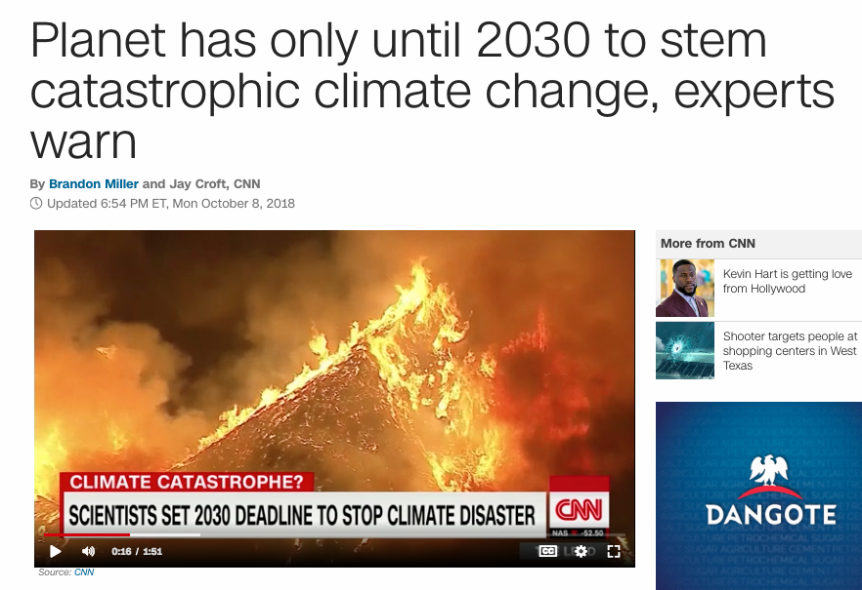
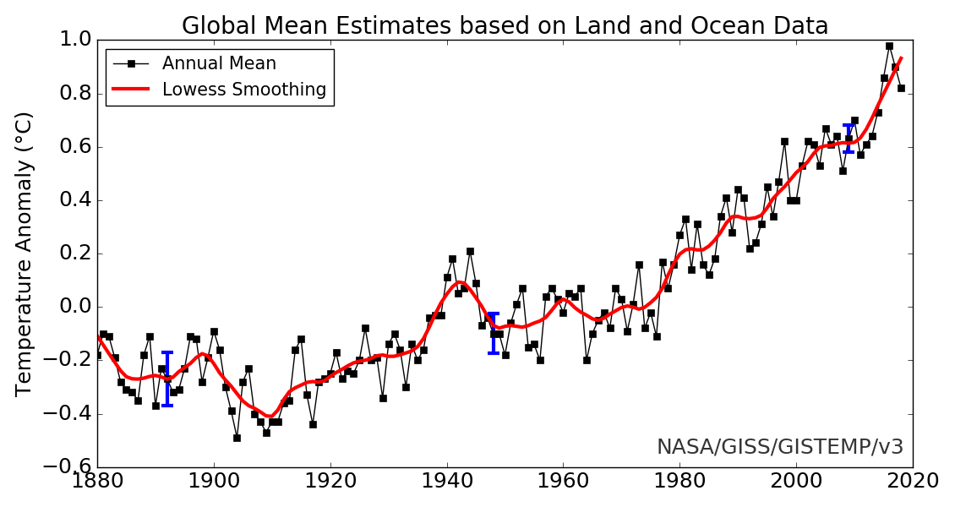
1.8
1.4
1.0
0.6
0.0
-0.6
-1.0
Temperature Anomaly (F)

Slide 4
Global Warming Science
Source: Chungin Goodstein

Slide 5
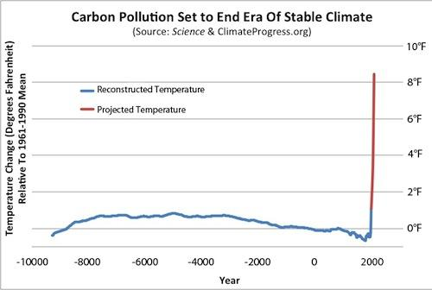
Current Path
Solve Climate
Source: Climate Progress, referencing Science (2013) and World Bank (2013)

Slide 6
“Solve Climate” Means….
By 2030, be well on the way towards a 100% renewable economy
Electric power from solar, wind, hydro, geothermal, + “storage” (batteries)
Transportation transitioning rapidly toward Electric Vehicles (EV’s)
This solves the energy half of climate change.

Slide 7
“Solar Dominance” Means
The point at which 50% of global electric power is produced by solar + storage
Why Solar Dominance?

Slide 8
Because…
By the mid-2020’s, “distributed” solar + storage in many places will be much cheaper then power from the grid.
And unlike with any other electricity source, you don’t need a utility. Millions and millions of people and companies can (and will) produce and store their own power.

Slide 9
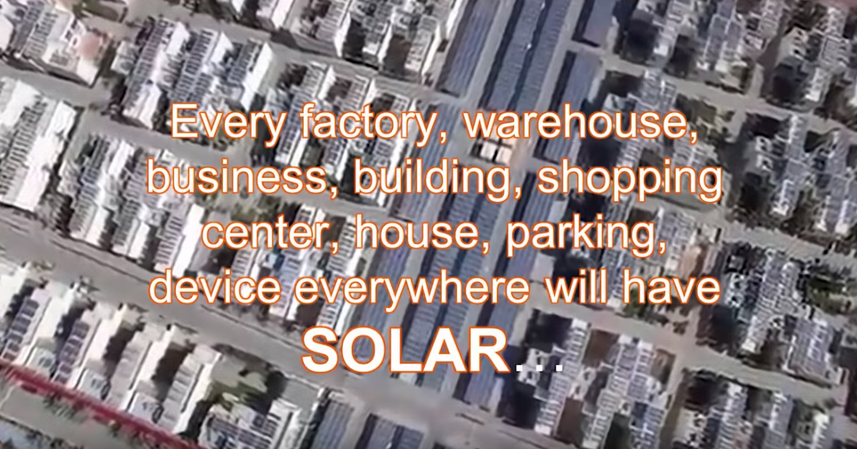
Source: Seba 2018
Solar Dominance is the future–
but how soon?

Slide 10
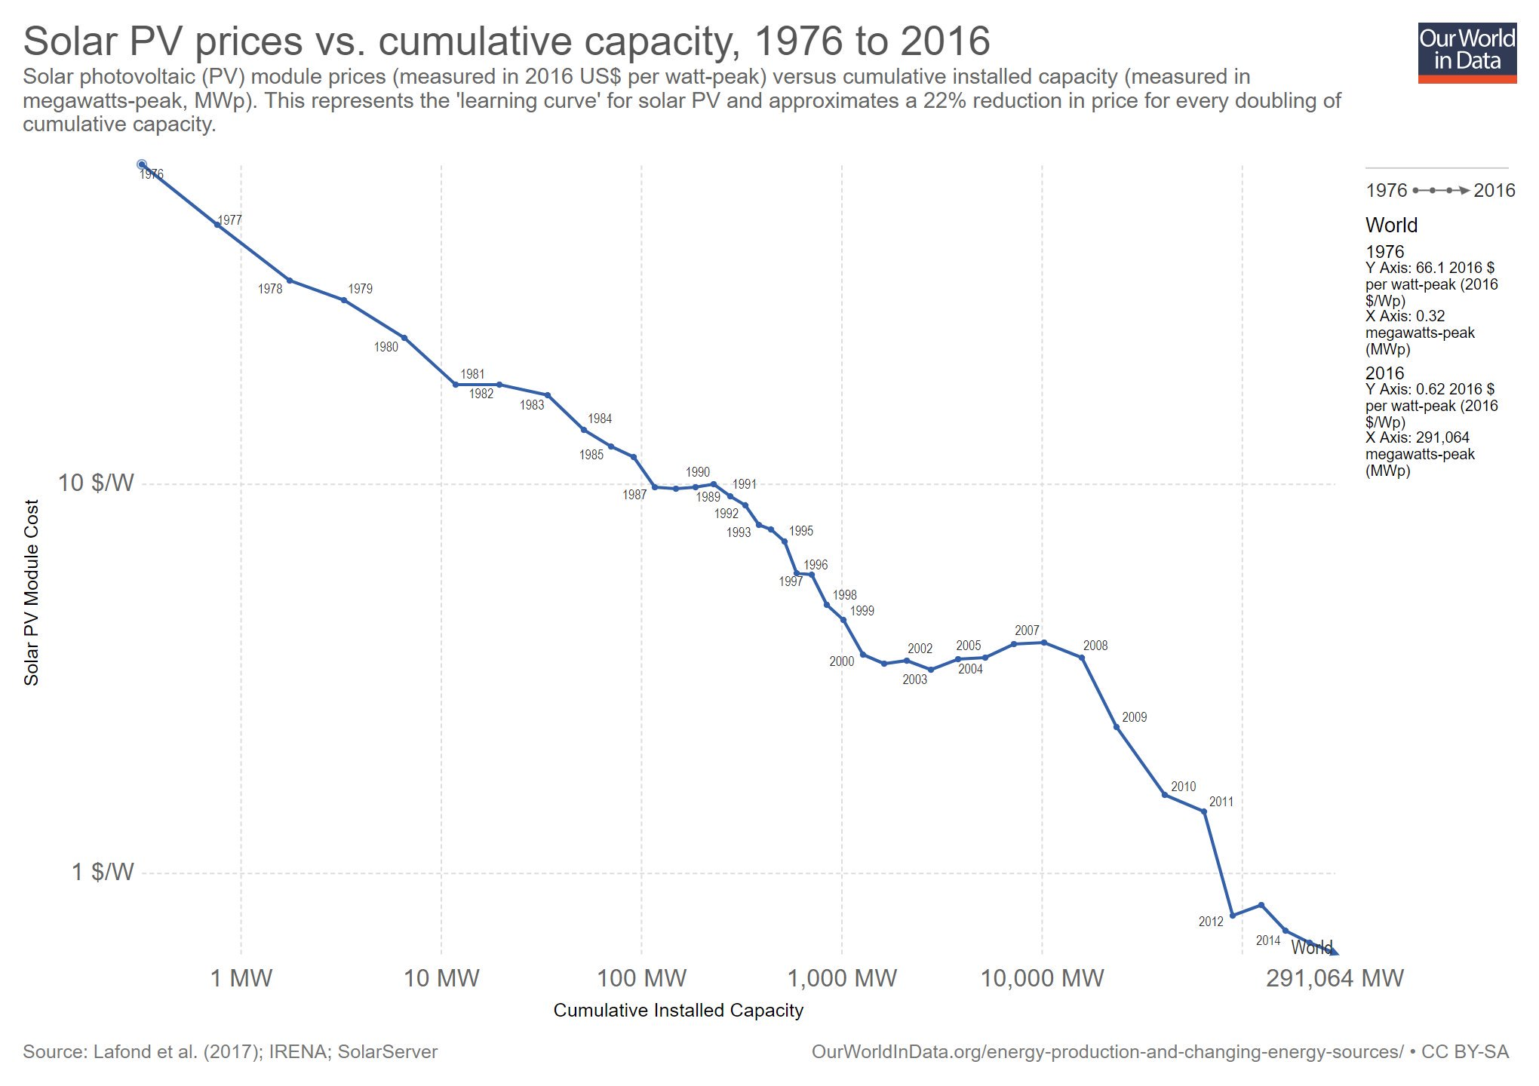
Solar Prices vs Cumulative Capacity 1976 to 2016
1977
$10/W
$1/W
2016
1 MW 10 MW 100 MW 1,000 MW 10,000 MW 290,000 MW

Slide 11
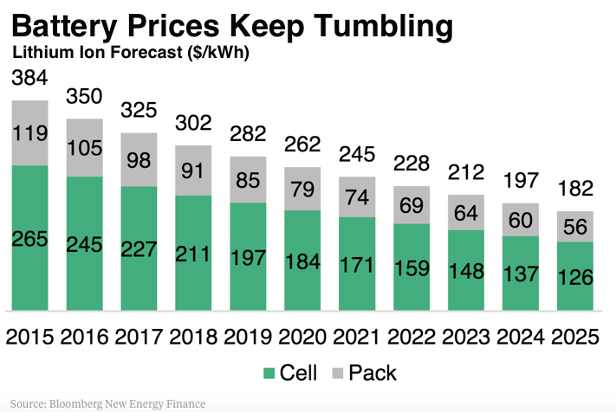

Slide 12
Price Of
Electricity
$/KWh
Distributed Solar + Storage at Parity (~2021)
Utility Scale Solar Below Parity (2019)
$.18
Retail Grid Price
$.13
Market Disruption
$.08
Distributed Solar + Storage
$.03
Utility Scale Solar
2018
2020
2022
2024
2026
2028
Solar Dominance in Leading US Markets
(Assumes ~8% cost reduction for solar + storage every year, less then the trend since 2000;
Distributed = residential, commercial, industrial rooftop + community scale)
Notes:
2018 Average US Residential Price, EIA
2021 Solar plus Storage Parity, predicted by Seba
2019 Utility Scale better than Parity: 2018 bids in Colorado, Arizona, Idaho
Increase in retail grid prices at 2% per year, due to grid maintenance and upgrades, and shrinking customer base.

Slide 13
“Partial Grid Defection”
Beginning soon, people and companies will increasingly use the grid as back-up power, but produce most of their power with solar + storage.
Utility death spiral? Maybe, but defection will be unstoppable.
Remember how we used to use telephone wires?

Slide 14
Source: Seba 2018
Solar Dominance is the future–
By 2030?

Slide 15
Is Solar Dominance by 2030 Possible?
2018
2%
2020
4%
2022
8%
2024
16%
2026
32%
2028
64%
Six doublings from 2018 gets the world to solar capacity powering 64% of today’s electrical needs.

Slide 16
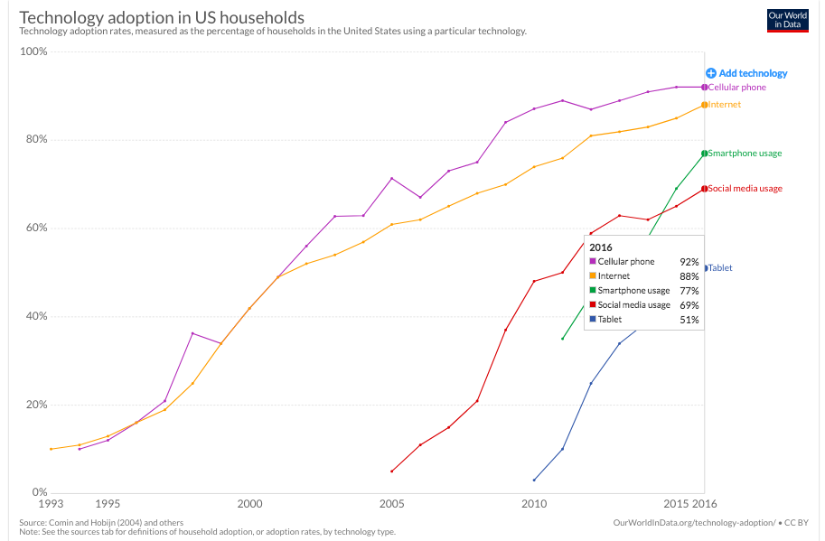
Disruptive Tech: Solar + Storage?
https://www.visualcapitalist.com/rising-speed-technological-adoption/

Slide 17
Solve Climate By 2030
100% Renewable Power
✔
What About Vehicles?

Slide 18
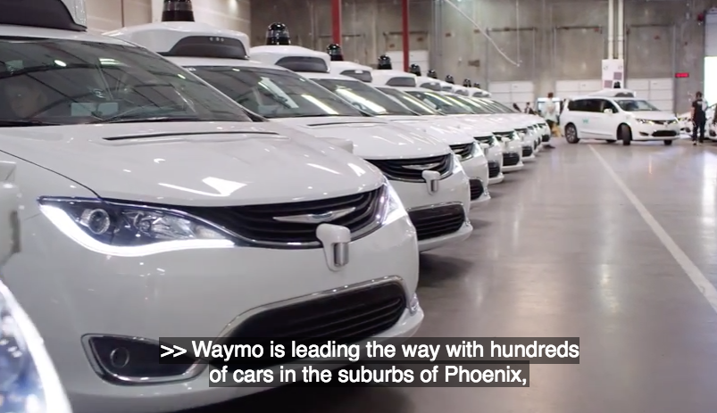
Gasoline -> EV Transition
By 2030?
Yes If:
“Autonomous Ride-sharing” Explodes

Slide 19
AEV Transport is the Future
These companies are not profitable without going driverless.
The first one wins.
AEV Fleets are going electric already because EV’s are much cheaper.

Slide 20
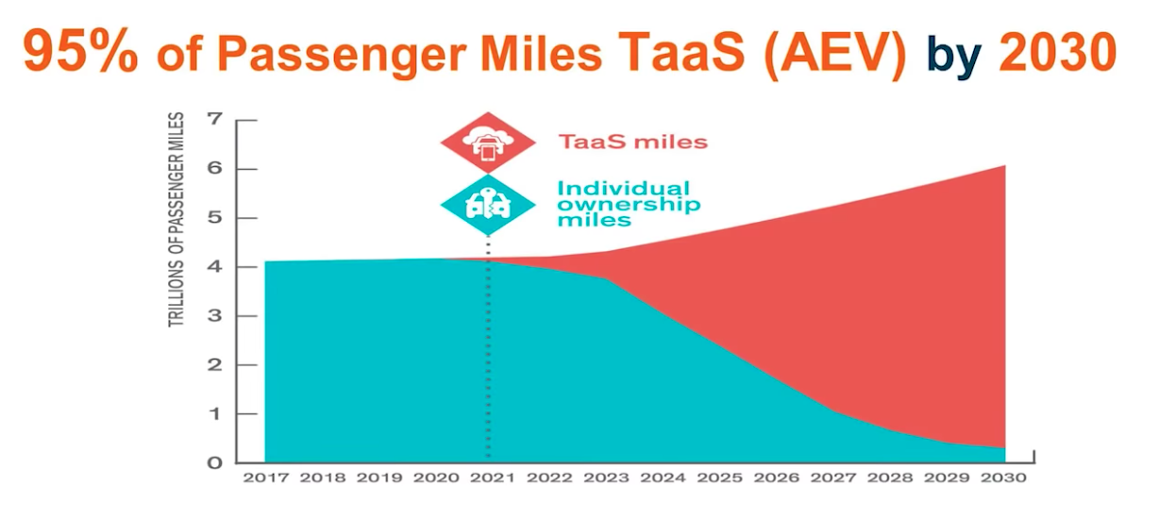
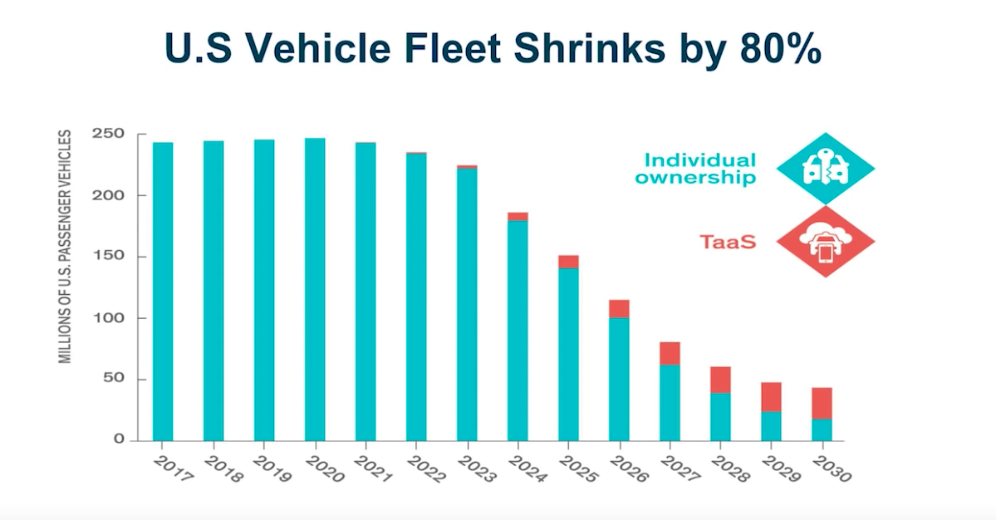
Will EV Ride-Sharing
Explode?
Seba 2018: Autonomous ride-sharing will be ready to go in 2021. At that moment, consumers (in leading markets) can--
Pay $900 per month for a new car
or
Pay $100 per month for a ride share subscription
Seba 2018
Seba 2018

Slide 21
Solve Climate By 2030
Powerful Market Forces are pushing towards:
Solar Dominance
Autonomous EV Ride-Sharing
But the market alone will not get us there fast enough…

Slide 22
Solar Dominance
+ Civic Action
Action: Speed the first solar + storage doublings through smart policies, often city/state/utility.
Action: Do the other 100 things to solve climate that don’t yet have the strong market forces that are driving rapid solar and storage adoption.
Action: Ensure a just and fair transition through the rapid energy (and social) disruption that is coming soon- regardless of government policy.

Slide 23
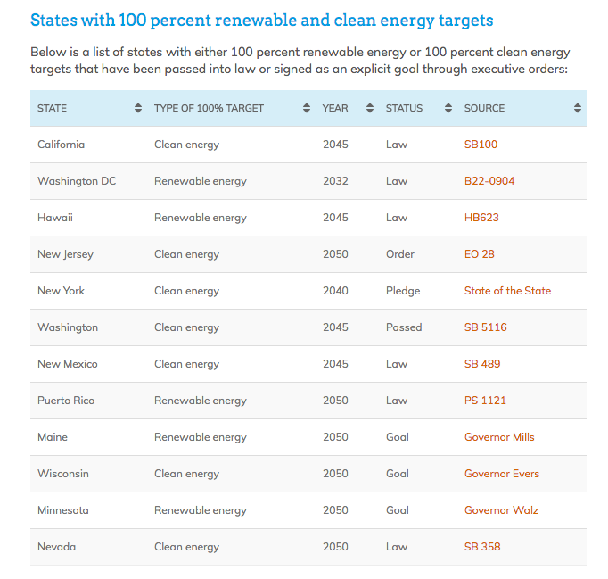
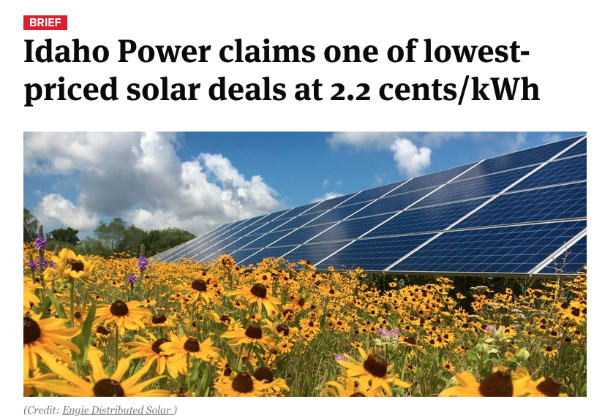
Civic Action: Speed the first solar doublings
https://news.energysage.com/states-with-100-renewable-targets/

Slide 24
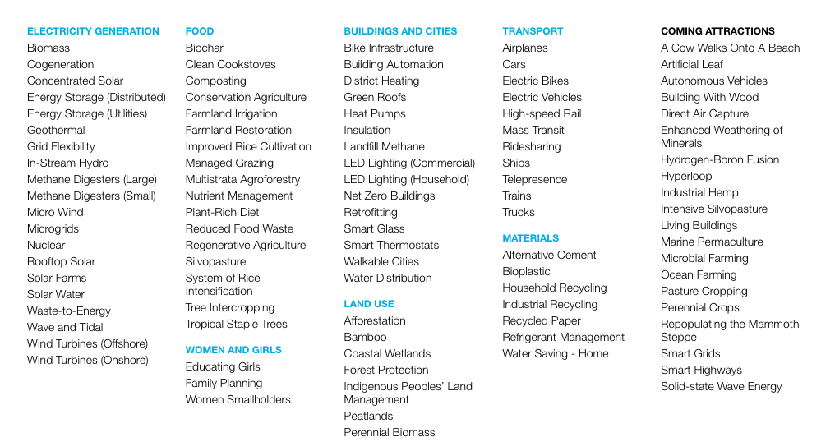
Civic Action: The Other 100 Solutions

Slide 25
Civic Action: Climate Justice
Ensure reliable affordable power and transport for all.
Ensure “green jobs” are accessible to all.
Ensure community voices at the table.

Slide 26
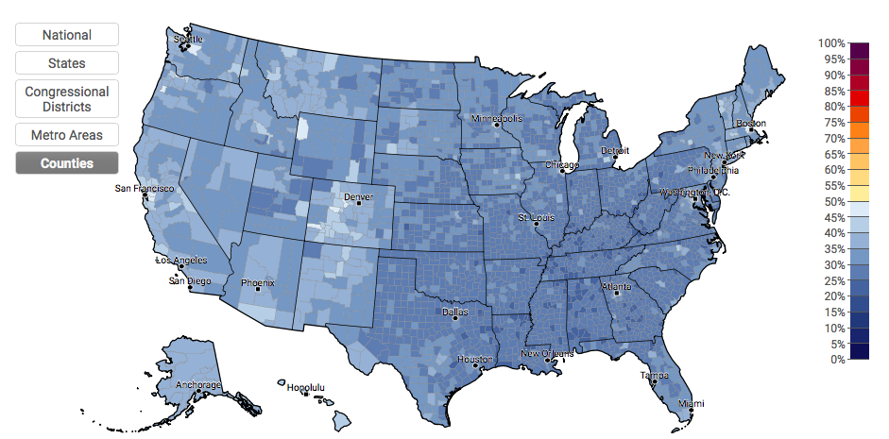
Talk Solving Climate by 2030
Estimated % of adults who discuss global warming at least occasionally, 2016
Source: Yale Center on Climate Communication

Slide 27
Get People Talking
April 7, 2020 – The Power Dialog
A nationally coordinated on-line event with hundreds of participating schools in every state: 52 hour-long, simultaneous, university-hosted webinars on state-specific solutions, followed by community dialogs focused on how students and citizens can take action.
University and
Business Sponsors

Slide 28
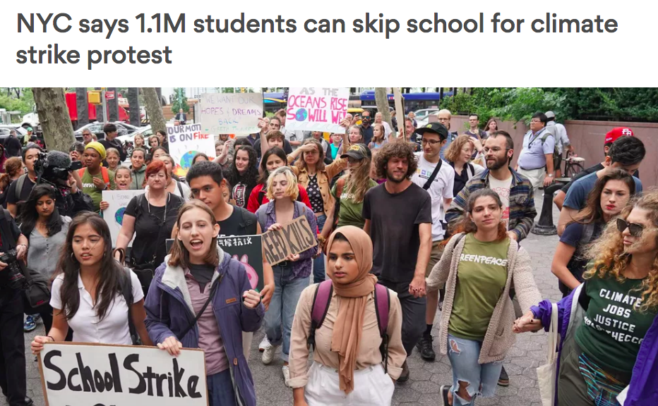
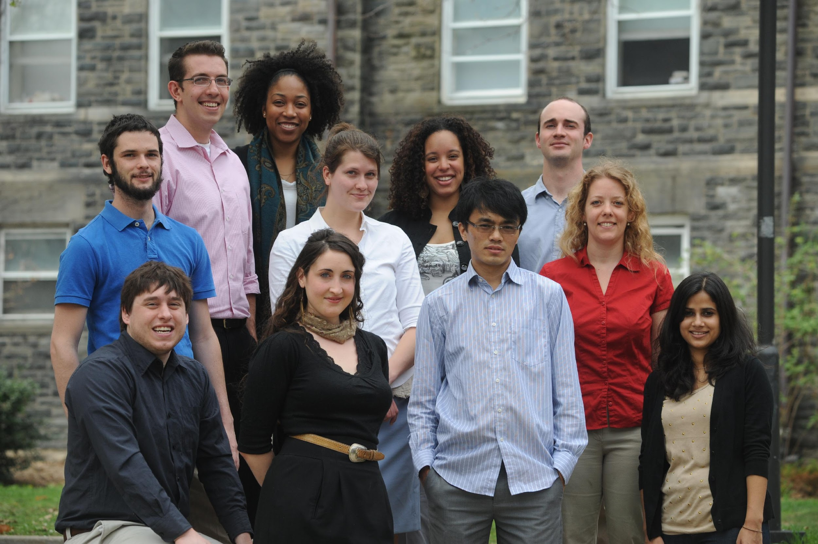
Solve Climate By 2030

